Slide 1
Machine Learning
& Ethics
William Seymour | Human Centred Computing
william.seymour@cs.ox.ac.uk

Slide 2
Overview
Introduction to Machine Learning (13:30-14:10, Access Grid)
Practical: Building a Classifier (14:20-15:00, Comlab)
Ethics in Machine Learning (15:10-15:50, Access Grid)
Ethical challenges in computer science
Academic work on ethics in ML
What does it mean to be fair?
Practical: Operationalising Ethics (16:00:16:30, Comlab)
Explaining image classifiers
Revisiting pred pol classifiers from earlier

Slide 3
Examples?

Slide 4
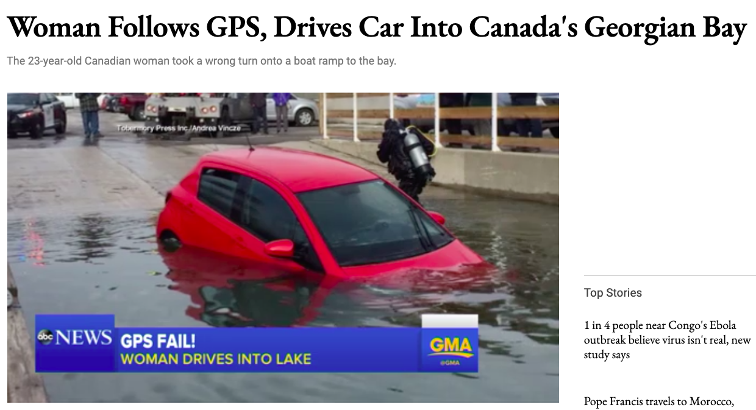
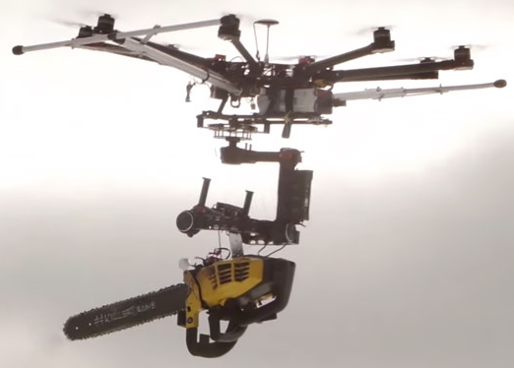
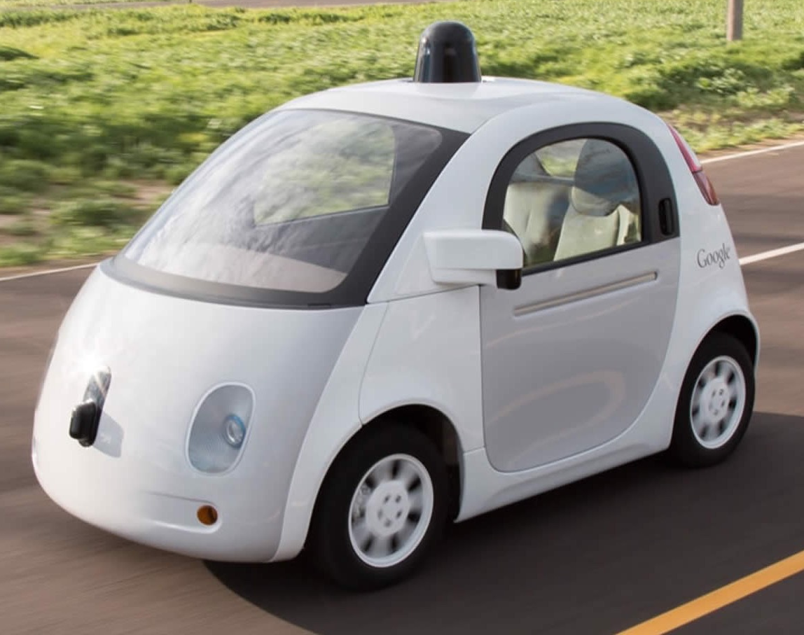

Slide 5
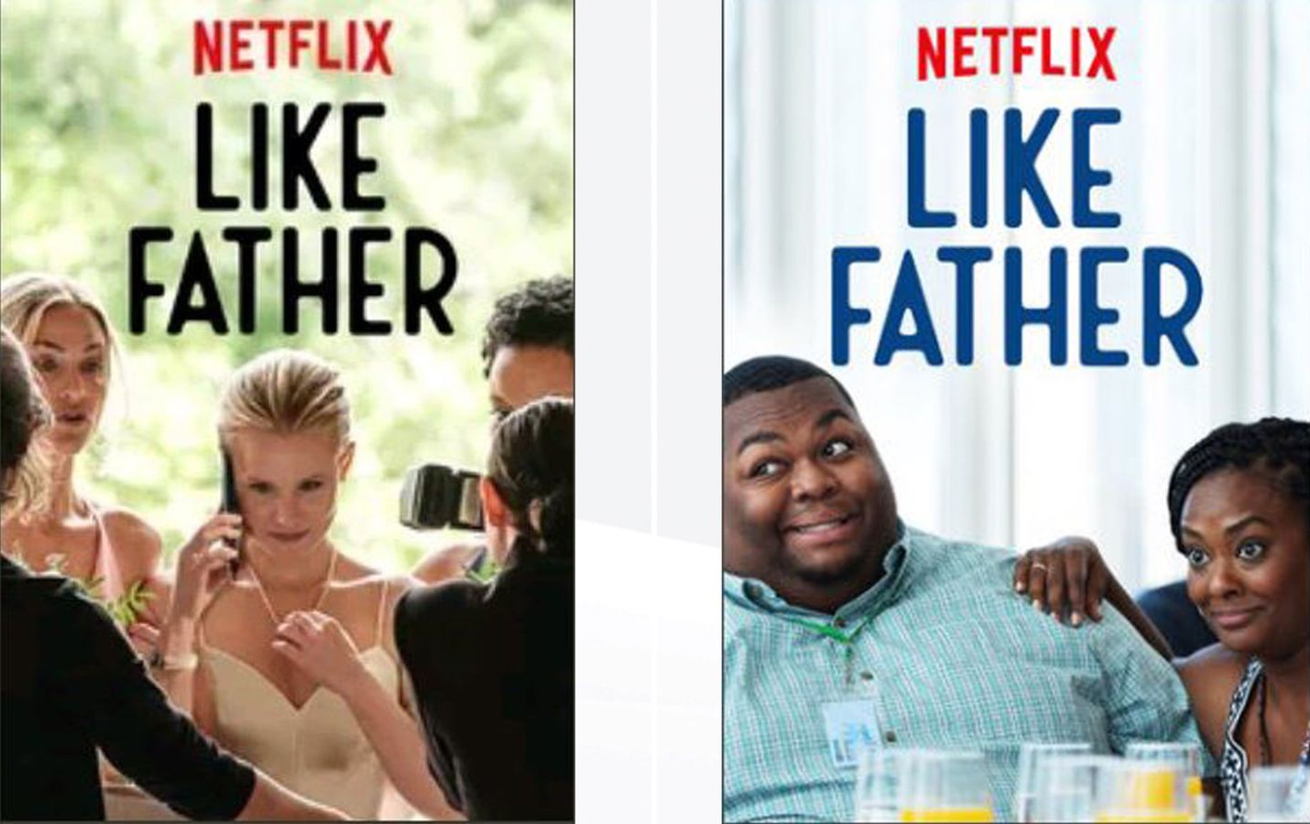
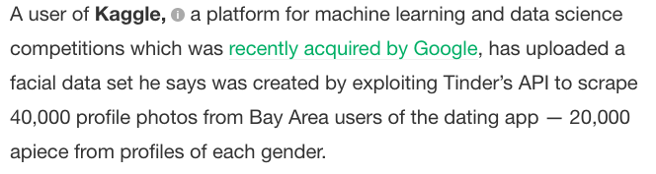
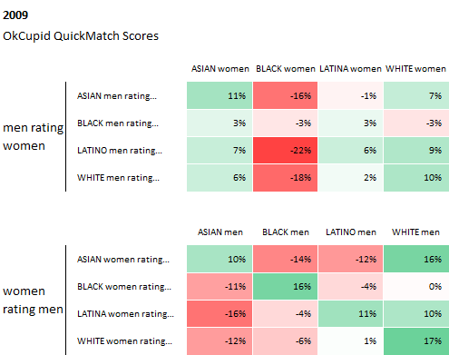
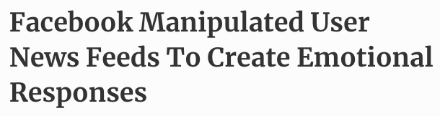

Slide 6
What can we do?
Codes of conduct / ethical guidance
Derive working definitions of what we consider “fair”
Data protection laws (e.g. GDPR)
FAT/ML: Fairness, Accountability, and Transparency

Slide 7
What can we do?
Codes of conduct / ethical guidance
Derive working definitions of what we consider “fair”
Data protection laws (e.g. GDPR)
FAT/ML: Fairness, Accountability, and Transparency

Slide 8
The Ethics of Algorithms
Inconclusive Evidence
Inscrutable Evidence
Misguided Evidence
Unfair Outcomes
Transformative Effects
Traceability

Slide 9
The Ethics of Algorithms
Inconclusive Evidence
Inscrutable Evidence
Misguided Evidence
Unfair Outcomes
Transformative Effects
Traceability

Slide 10
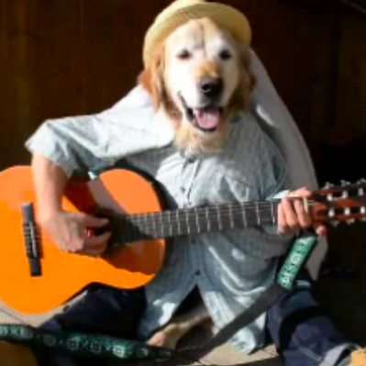
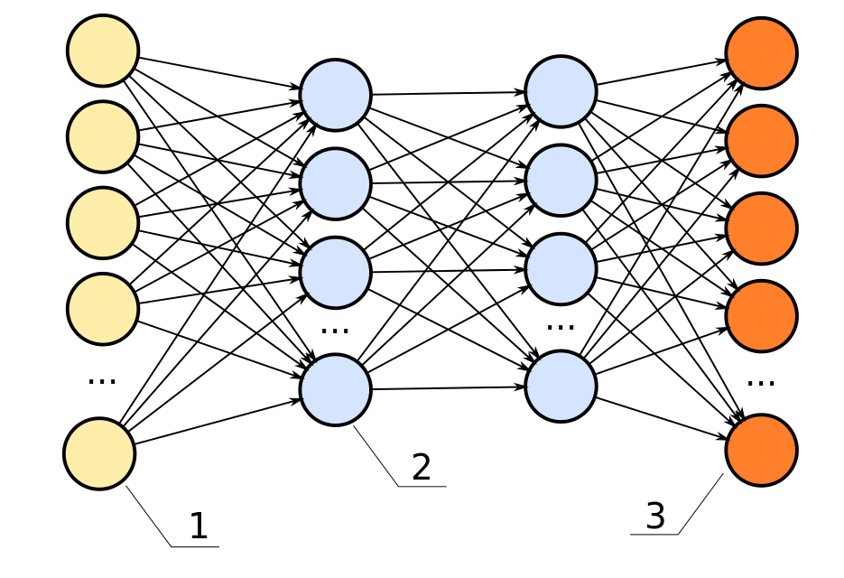
It’s a rabbit

Slide 11

You can’t get a loan

Slide 12
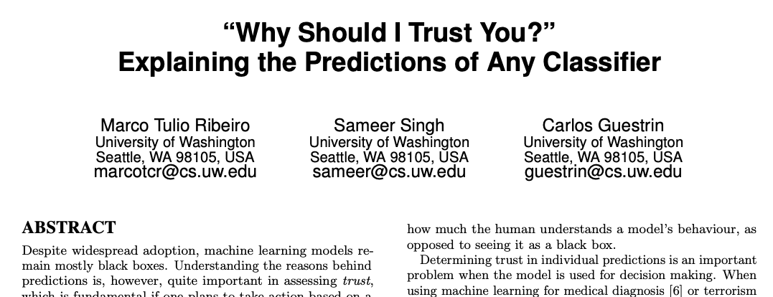
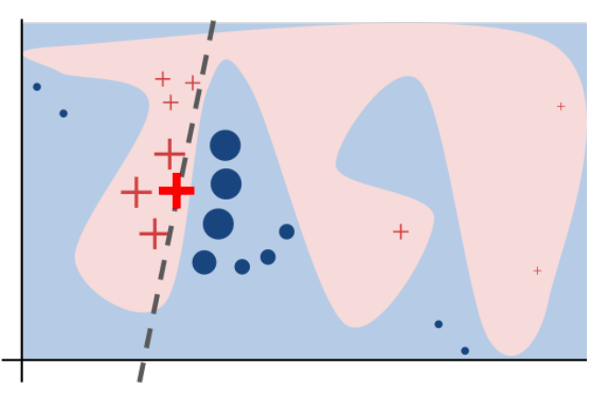

Slide 13
The Ethics of Algorithms
Inconclusive Evidence
Inscrutable Evidence
Misguided Evidence
Unfair Outcomes
Transformative Effects
Traceability

Slide 14
H1: Maximum Profit
Notes:
Best outcome for society as a whole

Slide 15

About that data set we used earlier...

Slide 16
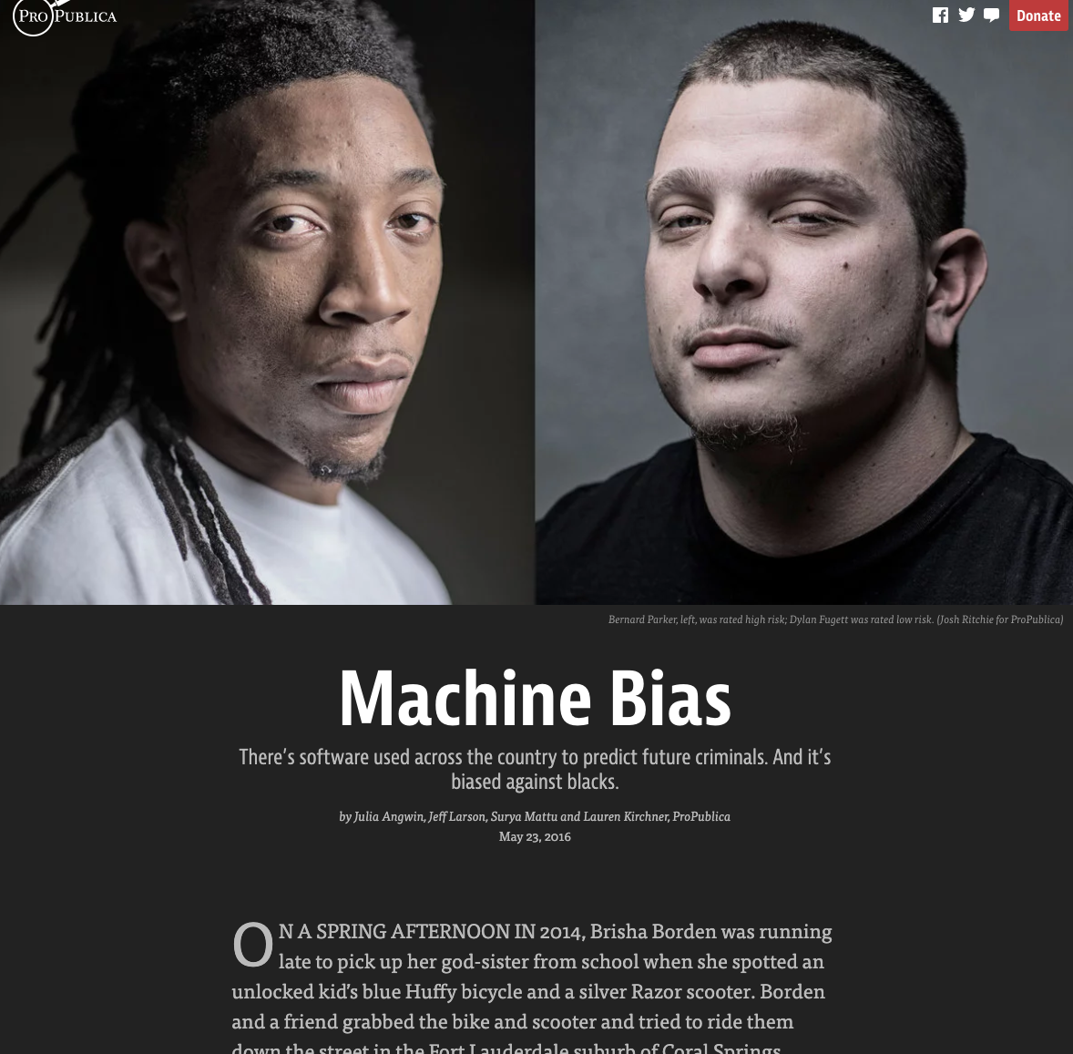
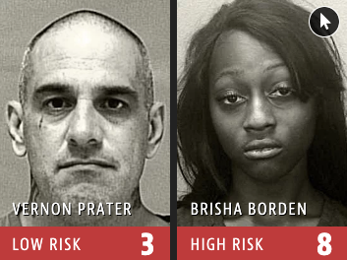
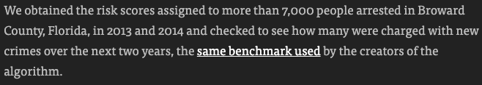

Slide 17
The personal impact of classification
Everyone that COMPAS classified was a real person
Classification scores were used to distribute services within prisons
In some states, COMPAS scores are used during sentencing
How many years of life disappeared due to this algorithm?

Slide 18
H1: Maximum Profit

Slide 19
Group | Count
Combined | 6172
African American | 3175
Caucasian | 2103
Hispanic | 509
Asian | 31
Native American | 11
Other | 343

Slide 20
Group | Count | Accuracy (%)
Combined | 6172 | 64.4
African American | 3175 | 64.6
Caucasian | 2103 | 64.9
Hispanic | 509 | 58.7
Asian | 31 | 74.2
Native American | 11 | 81.8
Other | 343 | 65.9

Slide 21
H2: Demographic Parity

Slide 22
Group | Count | Accuracy (%)
Combined | 6172 | 64.4
African American | 3175 | 64.6
Caucasian | 2103 | 64.9
Hispanic | 509 | 58.7
Asian | 31 | 74.2
Native American | 11 | 81.8
Other | 343 | 65.9

Slide 23
Group | Count | Accuracy (%) | P(Recid) (%)
Combined | 6172 | 64.4 | 48.4
African American | 3175 | 64.6 | 55.8
Caucasian | 2103 | 64.9 | 41.6
Hispanic | 509 | 58.7 | 38.7
Asian | 31 | 74.2 | 32.3
Native American | 11 | 81.8 | 54.6
Other | 343 | 65.9 | 37.9

Slide 24
H3: Equal Accuracy

Slide 25
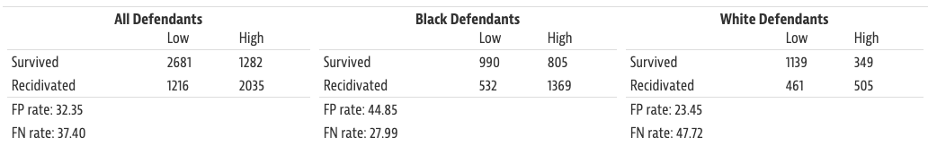

Slide 27
Who is Wronged?
True negative: low risk criminal given more lenient sentence
True positive: high risk criminal given harsher sentence
False negative: high risk criminal given more lenient sentence
False positive: low risk criminal given harsher sentence

Slide 28
H4: Equal Opportunity

Slide 29
Accuracy
FP
FN

Slide 30
Accuracy
FP
FN

Slide 31
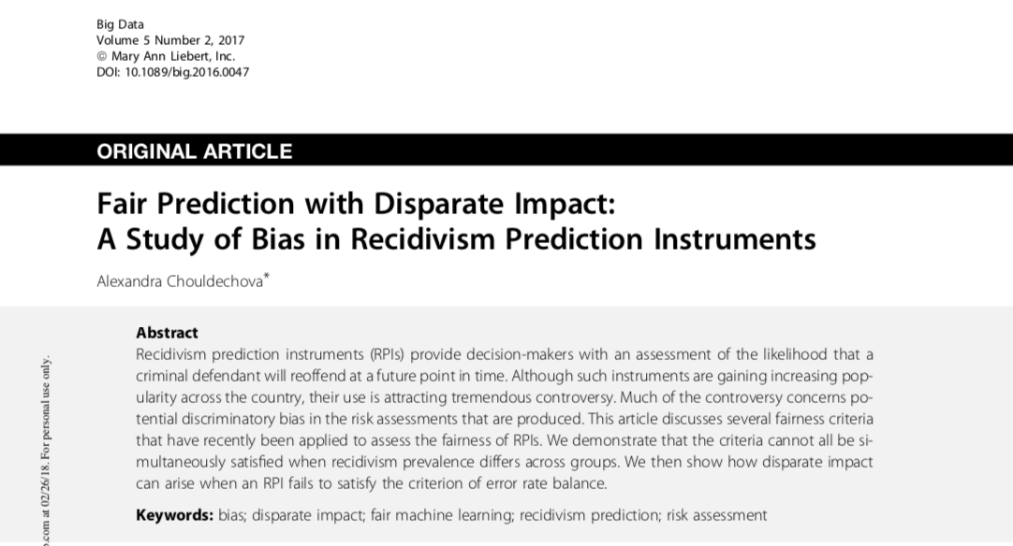
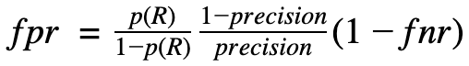
Group | P(Recid) (%)
Combined | 48.4
African American | 55.8
Caucasian | 41.6
Hispanic | 38.7
Asian | 32.3
Native American | 54.6
Other | 37.9
“When the recidivism prevalence—that is, the base rate P(Y=1;R=r)—differs across groups, any instrument that satisfies predictive parity at a given threshold must have imbalanced false positive or false negative error rates at that threshold.”

Slide 32
Can we just ignore {race, age, gender}?
Just excluding protected class data seems like an obvious option
Other features can act as proxies for protected classes
Might cause us to unwittingly perpetuate systemic discrimination

Slide 33
Practical #2
Explaining image predictions using LIME
Exploring unfairness in your classifiers from earlier
Do you think your classifier is fair?
How does it treat people of different groups?
Does it adhere to any of the fairness definitions we just covered?

